Slide 1
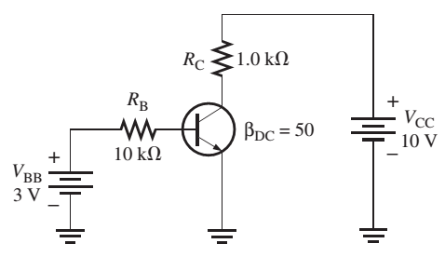

CO2015 Exercise on Bipolar Junction Transistor (NPN)

Slide 2
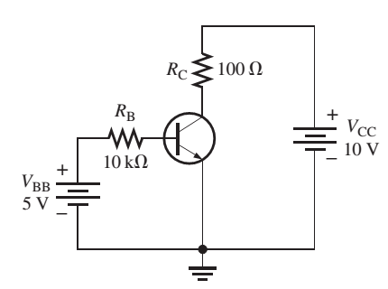
BJT Operation Modes
I_{B} = 0: Cut-off mode
V_{B} is increased (higher than 0.7V), I_{B} is increased:
I_{C} = β_{DC} I_{B}
Amplifier mode (Active mode)
V_{C} is increased
V_{C} = V_{CC} – V_{CE}
Saturation mode
V_{CE} is small (0.2V)

Slide 3
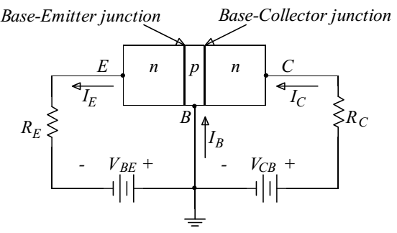
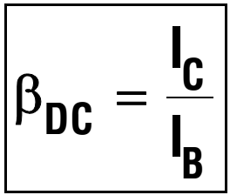
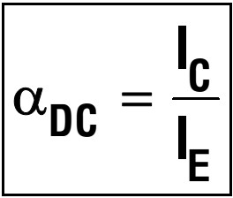
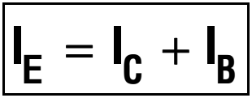
BJT in Amplifier Mode

Slide 4
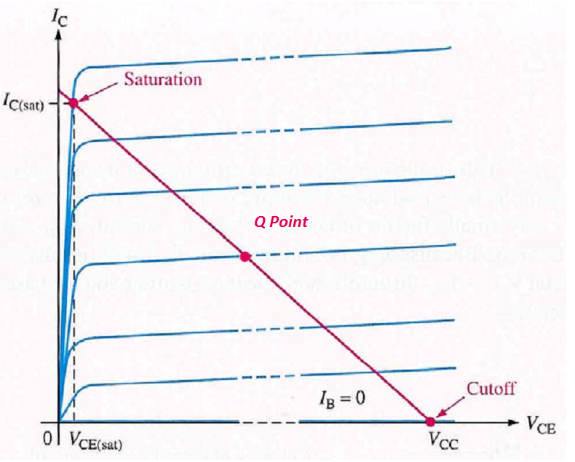
DC Load on I-V Curve

Slide 5
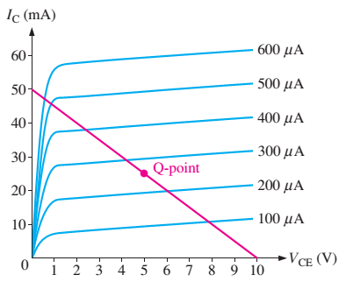
Example
Determine I_{C}(Sat)
Determine β_{DC}
I_{B}, I_{C} and V_{CE} at Q point
Notes:
Take any points in the graph, for instance, Ib = 100muA and Ic = 10mA
Beta = 100;

Slide 6
Answer
IC (Sat) = 50 (mA)
β_{DC} = 10mA/ 100muA = 100
At Q-point:
IC = 25 (mA)
VCE = 5 (V)
IB = 0.25 (mA)

Slide 7
Determine I_{B} ,I_{C} ,I_{E} ,V_{BE} ,V_{CE} and V_{CB} for the given circuit when β_{DC} = 150

Slide 8
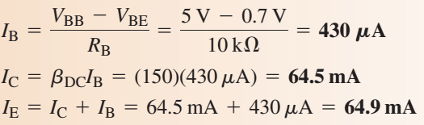

Slide 9
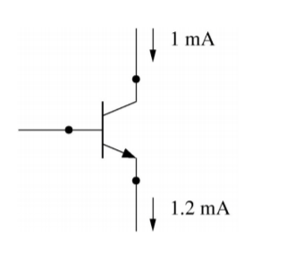
Find state of transistor (cut-off, amplifier or saturation) and its currents/voltages

Slide 10
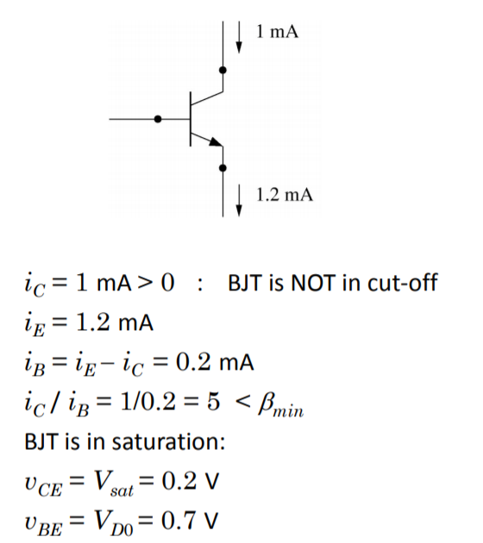
Answer

Slide 11
When a transistor is used as a switch, it is stable in which two distinct regions?
saturation and active
active and cutoff
saturation and cutoff
none of the above
Notes:
C

Slide 12
For a silicon transistor, when a base-emitter junction is forward-biased, it has a nominal voltage drop of
0.7
0.3
0.2
V_{CC}
Notes:
A

Slide 13
A certain BJT has I_{B} = 167uA, I_{C} = 15mA, the amplifier DC factor is:
15
167
90
All are not correct

Slide 14
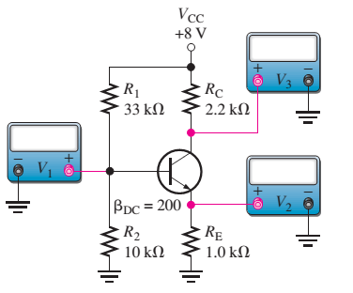
Exercise
Determine values on V1, V2, V3

Slide 15
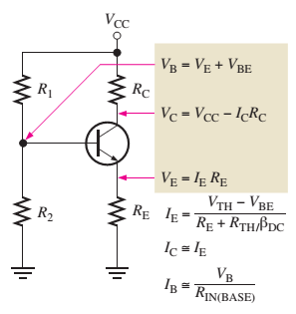
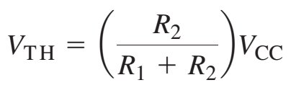
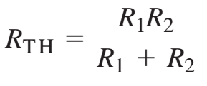

Slide 16
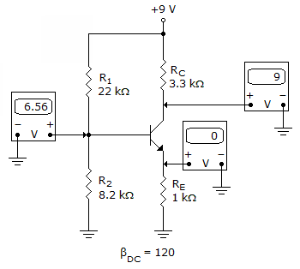
Refer to the given figure. The most probable cause of trouble, if any, from these voltage measurements is
Notes:
Base and Emitter is opened

Slide 17
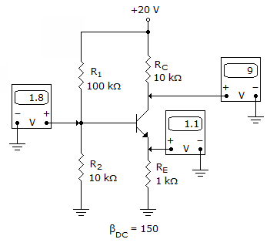
Refer to the given figure. The most probable cause of trouble, if any, from these voltage measurements is
Notes:
No problem

Slide 18
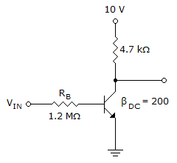
Refer to this figure. If V_{CE} = 0.2 V, I_{C(sat)} is

Slide 19
Refer to this figure. Determine the minimum value of I_{B} that will produce saturation (V_{CE}(sat) = 0.2V).
Notes:
10=4.7*10^3*Ic+0.2
Ic = 2.085 ma.
Ib = 2.085/200 = 10.425 uA .

Slide 20
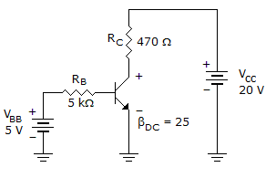
Refer to this figure. The value of V_{BC} is
Notes:
-9.2

Slide 21
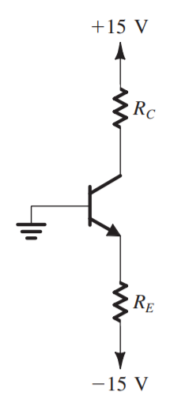
Determine R_{C}, R_{E}
V_{C} = 5V, I_{C} = 2mA
β_{DC} = 100
I_{C} = 2(mA)
V_{C} = 5(V)

Slide 22


Slide 23
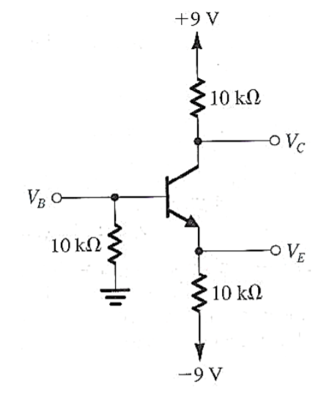
V_{B} = -1.5V
Calculate I_{B}, I_{C}, I_{E}
Notes:
IB = 0 – VB / 10K = 0.15mA
VE = VB – 0.7 = -2.2V
IE = -2.2 + 9/ 10k = 0.68mA

Slide 24
Midterm (60 mins – Closed Book)
28/03/2019
Multichoice + Written
Chapter 1: Basic Electronic Components
Deterimine the resistor values (4-band colors, 5-band colors)
LEDs connectors (Serial + Parallel)
Chapter 2: Diode
Diode Principles and Models
Applications using Diodes
Chapter 3: BJT (npn)
Amplifier Coefficient, Applications
Cutoff, Saturation and Amplifier modes
Vbe = 0.7 (for default)

